Slide 1
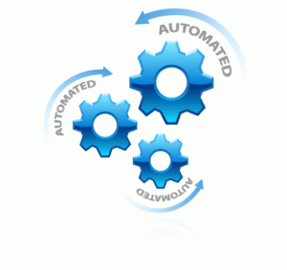

Build Test Automation Framework
Advanced Topics Test Automation
Software Quality Assurance
Telerik Software Academy
http://academy.telerik.com

Slide 2

The Lector
Anton Angelov
Senior QA Engineer @ Licensing Team
Blog: http://aangelov.com

Slide 3
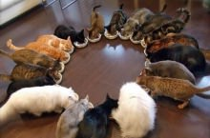
Table of Contents
Page Object Pattern
Base Test Class
Framework Extension Methods
Create Framework Scratch
More abstraction
Services
Interfaces
Dynamic

Slide 4

Benefits
Reusability Code
Separation of Concerns – Core + Test Logic
Easier Writing
Maintainability

Slide 5
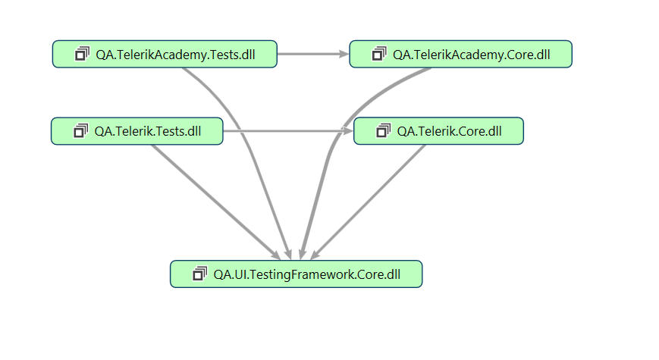
Project Structure

Slide 6
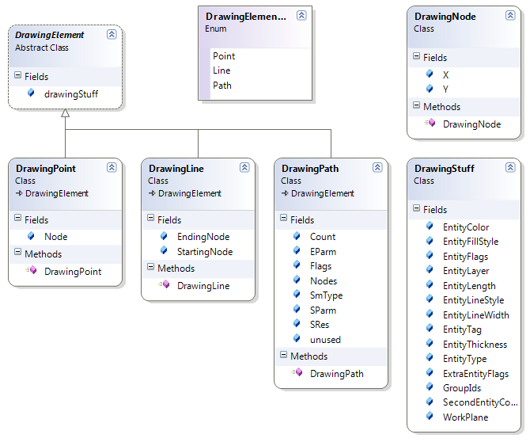

Page Object Pattern

Slide 7
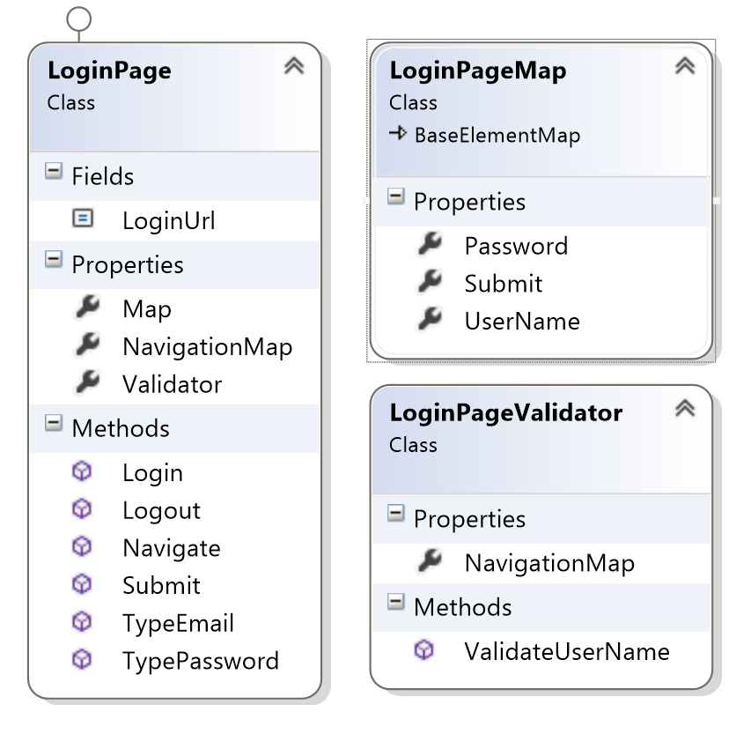
Page Object Pattern

Slide 8

Framework Core

Slide 9
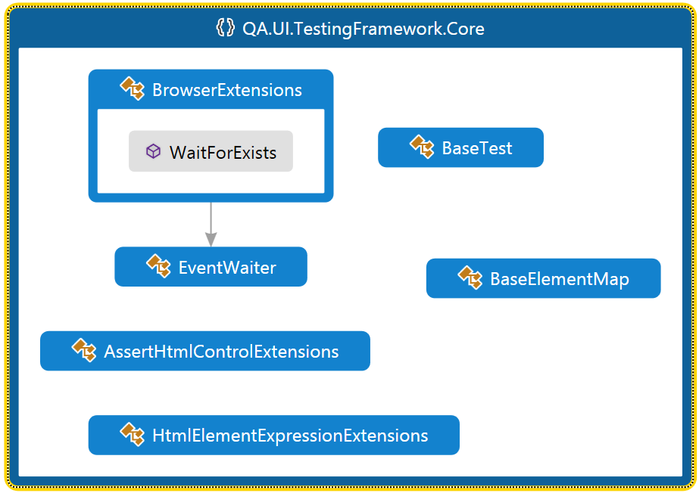
Framework Core (1)

Slide 10
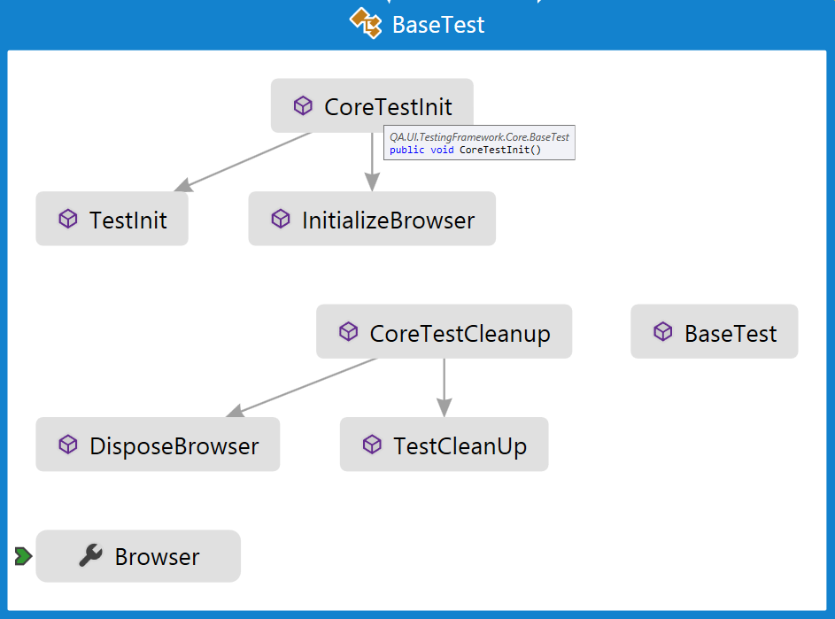
Framework Core (2)

Slide 11
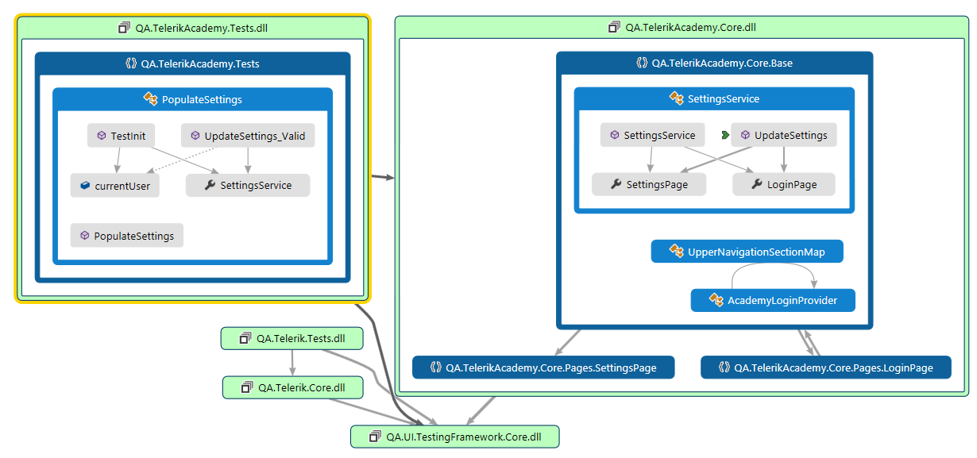
Abstraction-Services (1)

Slide 12
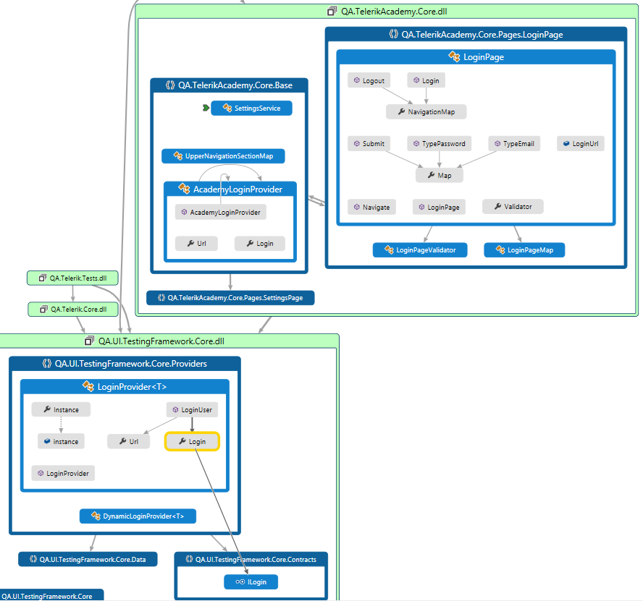
Abstraction-Interfaces (2)

Slide 13
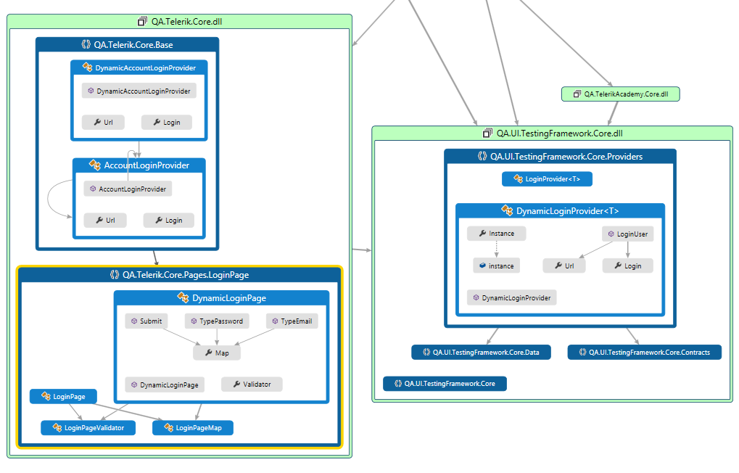
Abstraction-Dynamic (3)

Slide 14
Test Automation Framework
?
?
?
?
?
Questions?
?
?
?
?
?
?

Slide 15




Free Trainings @ Telerik Academy
C# Programming @ Telerik Academy
csharpfundamentals.telerik.com
Telerik Software Academy
academy.telerik.com
Telerik Academy @ Facebook
facebook.com/TelerikAcademy
Telerik Software Academy Forums
forums.academy.telerik.com

